Slide 1
EHL MAS and Adhesive Survey Update
Date: WW26’20
Intel Confidential and Customer Confidential Information
Never Share Outside of Intel

Slide 2
EHL MAS and Adhesive Survey Update
Risk Level:
Medium
Customer List:
APAC:
Advantech – Phase 1
Adlink – Phase 1
IEI - TEP
Aaeon – Phase 1
EMEA:
SECO - TEP
Congatech - TEP
MSC – Phase 1
Siemens (just email) - TEP
Summary:
Medium Risk: Pending to know customers reliability data and their final decision for corner glue application by end of June. QS will be WW36/38.
Medium Risk: Potential schedule impact if required board design change and add KOZ for corner glue application after knowing reliability testing result.
  Options:
  Fab spin, potential schedule impact.
  Applying corner glue with make sure encapsulate adjacent passive part. This is a workaround solution but not so manufacturing friendly process.
IoTG customers define product reliability based on whole system functionality and not focus on SJR.
  Opportunity to train IoTG customers about what is SJR during IPTS (Nov/Dec 2020).
Adhesive is not a common process for IoTG customers. Customers may have some adhesive experience but depending on request either from OEM customers / R&D team.
No EHL SMT yield issue encountered with limited samples build. Customers are well aware about stencil design recommendation in MAS.
Legal: If customers don’t follow the MAS recommendation, a disclaimer on MAS is able to protect Intel and avoid compensation if any SJR issue related happen in future.

Slide 3
Next Steps:
To ping all remaining TEP & Phase 1 Customers, ask these questions (due date June 26th)
  Based on the corner glue recommendation in the EHL MAS & TMDG, do you have any plans to add corner glue on the EHL package? (Expected Response: “Yes”, “No” or “Pending”)
  If answered “No”: No further information is needed from the customer.
  If answered "Yes": Are you working with a local corner glue vendor to help your factory add corner glue on the EHL package?
  If answered "Yes": Do you need any additional help from Intel's Enabling Team to add corner glue on the EHL package?
  If answered "Pending": By when and with what data is needed to make the EHL corner glue decision?
EHL Temperature Cycle data review by August.
Proactive Proposal Long Term Collaboration:
Request customers EHL boards for temperature cycle testing. Preferred to use QS samples.
Customers SJR risk assessment with using TCx profile.
Bin
Reason: More critical is to know what is customer true requirement

Slide 4
EHL Adhesives Guidance
Intel recommends the use of corner glue (CG) for Elkhart Lake for certain product use cases. The below chart is a guideline for temperature cycle risk based on solder ball temperature and power cycles.
If your product falls above the “Product Capability” line, CG may be advisable to increase the capability of the package solder joints. For more information and manufacturing guidance, please see the documents titled “Manufacturing with the Intel Platform Code Named Elkhart Lake” (RDC #621789) and “Manufacturing with Intel Products Adhesive Guidance for Ball Grid Array and Package on Package” (RDC #573768).
Tsb Guidelines:
Tsb (Temperature at solder ball) is dependent on silicon junction temperature as well as the heat dissipation of the thermal solution. The below ranges are a general guideline for determining Tsb range without having a full system thermal model available.
High Tsb: E.x.: passive metal heat sink with no air flow, closed chassis
Medium Tsb: E.x.: heavy heat sink with some air circulation (i.e.: vented chassis)
Low Tsb: E.x.: heavy desktop-like heat sink with forced air flow (i.e.: integrated fan )
Low
Intel recommends that all customers perform their own reliability evaluation to make sure that the product meets their expected requirements based on their own methodology.

Slide 5
Assumptions/Definitions
Power cycle
  On to off cycle (assuming cooling down to ambient temperature when off)
  On to standby cycle (assuming cooling nearly to ambient when in standby)
Ambient temperature
  Temperature external to system (room temperature)
  Assumed to be 24 C
The given product temperature cycle risk was calculated assuming a minimum 1.6 mm board with a 15 lbf load and no backing plate. Changes in board thickness, loading, or presence of a backing plate can affect temperature cycle risk

Slide 7
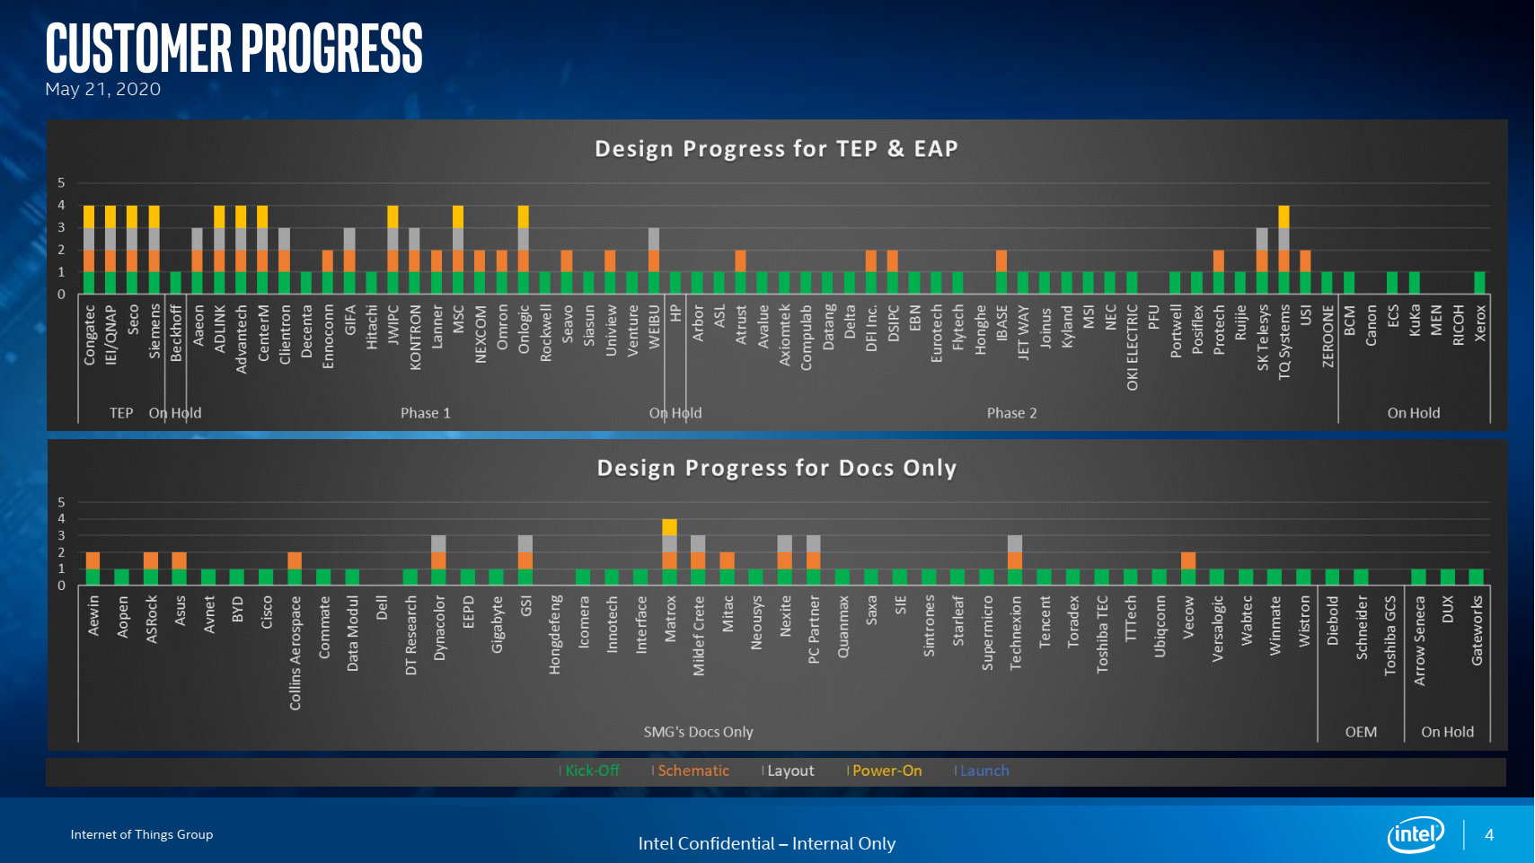

Slide 8
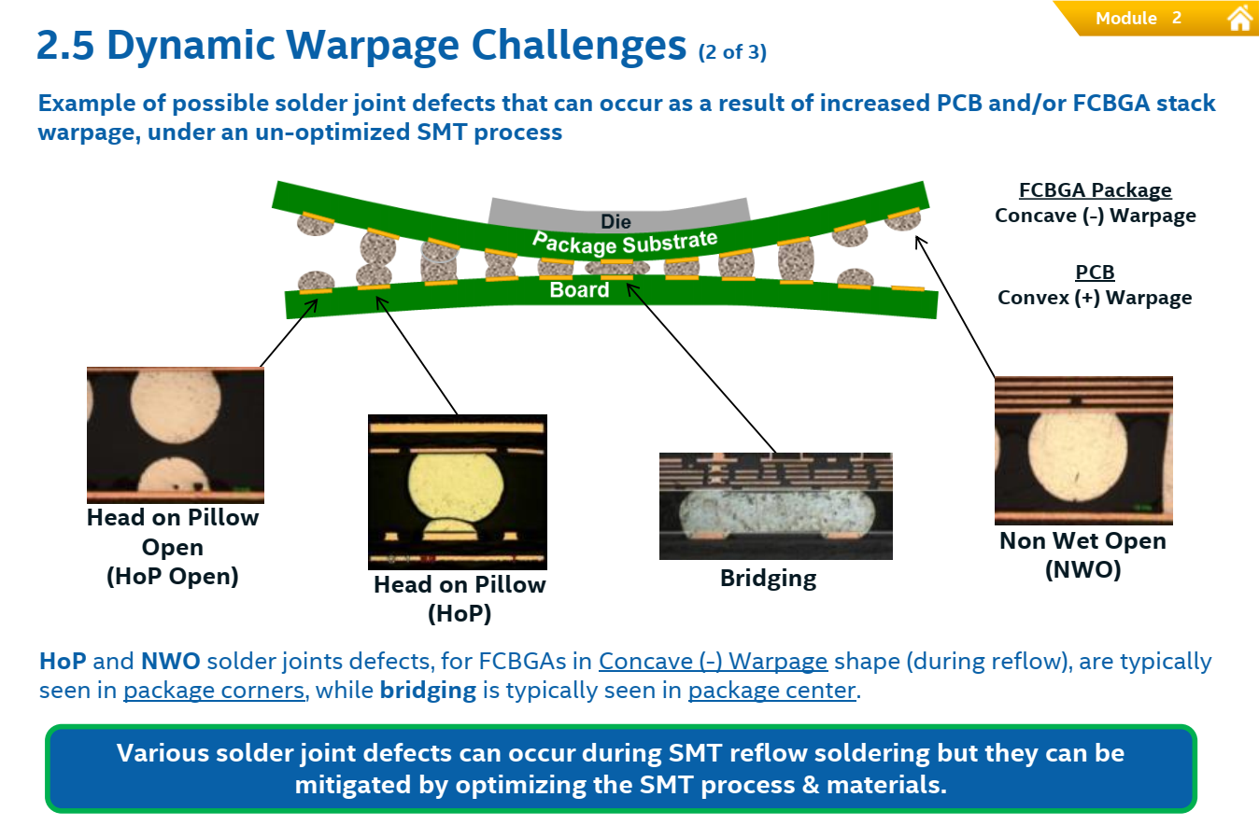

Slide 9
EHL Customer List

Slide 10
Content:
Customer’s Surveyed -> IOTG Sales Volume
Survey Summary Information
Market Segment, Power Cycles & Temp Conditions
Board Level Temperature (TC) Testing
Adhesive Usage

Slide 11
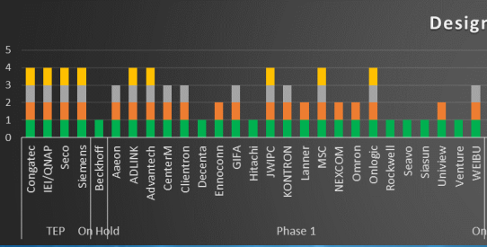
Customer Survey IOTG Sales Volume
IOTG Sales Volume on Apollo Lake, Gemini Lake & Valley View:
Parent Customer | APOLLO LAKE | GEMINI LAKE | VALLEYVIEW | 2017-18 sum APL+GLK+APL | EA Customer? | time factor | vol*tf | %
Advantech | 29047 |  | 508675 | 537722 | EA1 | 1 | 537722 | 4.6%
IEI | 136275 | 3068 | 248095 | 387438 | TEP | 1 | 387438 | 3.3%
ADLINK Technology | 55155 |  | 277849 | 333004 | EA1 | 1 | 333004 | 2.9%
AAEON | 36154 |  | 179144 | 215298 | EA1 | 1 | 215298 | 1.9%
Congatec AG | 33303 |  | 171565 | 204868 | TEP | 1 | 204868 | 1.8%
Kontron | 8638 |  | 184156 | 192794 | EA1 | 1 | 192794 | 1.7%
MSC Vertriebs GmbH | 1363 |  | 154717 | 156080 | EA2 | 1 | 156080 | 1.3%
Beckhoff GmbH | 100 |  | 82350 | 82450 | TEP | 1 | 82450 | 0.7%
Hitachi |  |  |  |  |  |  |  | 0.0%
Omron |  |  |  |  |  |  |  | 0.0%
SECO |  |  |  |  |  |  |  | 0.0%
Siemens |  |  |  |  |  |  |  | 0.0%
TQ |  |  |  |  |  |  |  | 0.0%
Weibu |  |  |  |  |  |  |  | 0.0%
 |  |  |  |  |  |  |  | 18.2%
This Customer Survey represents ~18% of IOTG Sales Volume on APL, Gemini Lake & Valleyview
This Customer Survey represents ~52% (14/27) of the EHL TEP & Phase 1 Customers

Slide 12
Survey Summary Information (Page 1 of 2)
EHL Customers Surveyed
Customer | Market Segment
 | Market segment for the product
Adlink | Industrial & EBM (designing a COM module, a generic soln, to be used in medical, defense, transportation & robotics segments)
Advantech | AIMB-218 plan go into digital signage, EBM, Industrial, kiosk, and Automation market
Aaeon | Industrial
Beckhoff | TBD
Congatec | Plan to use in same segments as APL (PC Client, Embedded and Industrial. Not FuSA.)
Hitachi | Industrial
IEI x QNAP | Industrial & EBM
Kontron | TBD
MSC (Avnet) | Industrial: We are making computer modules according to industries standards like COM-Express, SMARC, Q7. We sell these modules into all kind of markets. Some do run 24 by 7 at high loads. In HMI applications they run often in sleep mode and wake up as the user requests something. Environmental wise we offer industrial temp modules (-40 to 85 C) as the highest standard. PC Client: For other applications we produce PC-client type modules.
Omron | Industrial
SECO | FuSA and EBM
Siemens | Industrial and EBM
TQ | EBM
Weibu | PC Client
14 Total Customers Surveyed. 12 Customers have responded, working on 2 more responses.

Slide 13
Survey Summary Information (Page 2 of 2)
Product Power Cycles
Range of Industrial # power cycles (on to off) is 0 to 4 cycles per day
Range of PC Client # power cycles (on to off) is 1 cycles per day
Range of Industrial # power cycles (active-to-standby) is 0 to 20 cycles per day
Range of PC Client # power cycles (active-to-standby) is 5 cycles per day
Product Temperature Conditions
Range of standby/idle temp of Intel SOC: -40°C to 100°C
Range of active temp of the Intel SOC: -40°C to 105°C
Range of ambient of system location: -40°C to 100°C
Board Level Temperature Cycling (TC) Testing
Range of Board thicknesses: 1.2mm (47mils), 1.4mm (55mils), 1.6mm (62mils), 2.0-2.4mm (79-94mils)
4 Customers appear to run an Accelerated SJR TC Test like Intel
  Congatec: Require 1850 cycles for a 10 year life (185 cycles per year)
  Hitachi: Require 545-1250 cycles, unloaded test, -55°C to 125°C [IOTG believes they have high rqmt’s]
  Omron: Require 1000 cycles, -40°C to 100°C [IOTG believes they have high rqmt’s]
  Siemens: Require 1000 cycles, loaded test, -40°C to 125°C
8 Customers – we are unsure if they perform an Accelerated SJR TC Test like Intel
  The testing they perform looks more like a factory infant mortality or ‘power cycling’ test, tests related more for performance & functionality. Need to clarify with these customers
Adhesive Usage
4 customers have some type of board level adhesive experience & setup (but may not be for BGAs or using thermal cured adhesives)
8 customers don’t have any board level adhesive experience

Slide 14
Market Segment, Power Cycles & Temp Conditions (Page 1 of 2)
Customer | Market Segment | Product Power Cycles |  | Product Temperature Conditions
 | Market segment for the product | Avg # of On to Off power cycles a day | Avg # of active to standby (active to idle) cycles a day | Avg Standby or idle temp of the Intel SOC in the system | Avg Active temp of the Intel SOC in the system | Avg ambient (RT) at location of where the system is used
Adlink | Industrial & EBM (designing a COM module, a generic soln, to be used in medical, defense, transportation & robotics segments) | Unknown | Unknown | Unknown | 70% of cases, T-ambient is 70°C. 30% of cases, T-ambient is 85°C. | Medical inside hospital. Defense on all kinds of diff environ’s. The ambient temp can be max to 85°C.
Advantech | AIMB-218 plan go into digital signage, EBM, Industrial, kiosk, and Automation market | <5 times/day | <5 times/day | -20 to ~75°C, depends on user scenarios | -20 to ~75°C, depends on user scenarios | Unknown, customer will use both indoor and outdoor
Aaeon | EMB (For Industrial info, need to contact with other PM) | Depends on Customer’s user scenario’s | Depends on Customer’s user scenario’s | 35°C | 55°C | Standard: 0 to 60°C
Congatec | Plan to use in same seg’s as APL (PC Client, Embedded and Industrial. Not FuSA.) | Product pwr cycles vary sig. over the diff. field of app’s of our customers. For some Industrial use cases we assume the module to be operated for at least one shift before it experiences a full on / off pwr cycle. The ratio of on / off cycles in respect to the run time in hrs is roughly 1/10 (meaning one on / off cycle comes with (at least) 10 hrs of operating time) |  |  |  | -40°C to 85°C can be achieved in customers environments
IEI x QNAP | Industrial & EBM | N/A | N/A | 60 to 70°C | It depends on which CPU Platform | Indoor chamber with normal stream (25 Deg C)
SECO | FuSA and EBM | 2 cycles per day | 2 cycles per day | TBD, client dependent | TBD, client dependent | TBD, client dependent
Siemens | Industrial and EBM | N/A | N/A | 365/7/24 | 105°C (Tj) | 60°C (Max)

Slide 15
Market Segment, Power Cycles & Temp Conditions (Page 2 of 2)
Customer | Market Segment | Product Power Cycles |  | Product Temperature Conditions
 | Market segment for the product | Avg # of On to Off power cycles a day | Avg # of active to standby (active to idle) cycles a day | Avg Standby or idle temp of the Intel SOC in the system | Avg Active temp of the Intel SOC in the system | Avg ambient (RT) at location of where the system is used
MSC (Avnet) | Industrial. We are making computer modules according to industries standards like COM-Express, SMARC, Q7. We sell these modules into all kind of markets. Some do run 24 by 7 at high loads. In HMI applications they run often in sleep mode and wake up as the user requests something. Environmental wise we offer industrial temp modules (-40 to 85 C) as the highest standard. For other applications we produce PC-client type modules. | 0-1 cycles/day | 0-20 cycles/day | 30 to 40°C | 50 to 60°C | -20 to 50°C
Omron | Industrial | 3 cycles/day | 3 cycles/day | 75°C Max | 85°C (Board temp) | 55°C
TQ | EBM | 24/7 to 100/day is possible (depends on the customer) | Depends on customer usage and running SW | We specify -40 to 100°C for SoC (depends on customer usage) | We specify -40 to 100°C for SoC (depends on customer usage) | We specify -40 to 85°C for system (depends on customer usage)
Weibu | PC Client | 1 cycle/day | 5 cycle/day | 30°C | 45°C | 26°C
Beckhoff | TBD
Kontron | TBD
Hitachi | Industrial | 0 (Continuous Operation) | 0 (Continuous Operation) | 30°C | 50°C | The system will be in an air conditioned area at an avg ambient temp from 5 to 35°C

Slide 16
Board Level Temperature Cycling (TC) Testing (Page 1 of 4)
Customer | Market Segment | Board Level Temperature Cycling (TC) Testing
 | Market segment for the product | We perform board level TC | Board or system level TC performed | Loading Param’s for board level TC | Board thickness for board level TC | Temp range for board level TC | Cycle length (incl dwell time) for board level TC | Temp ramp rate for board level TC | Adhesives used on Intel SOC for board level TC | How are board level TC results are monitored | Rqmt for qty of board level temp cycles | Success Criteria for board level TC (# of fails allowed from tested pop) | Passing Criteria for board level TC (how a failure is defined)
Adlink | PC Client, Industrial & EBM | Yes | Board level & system level | based on board design requirement | PC: 1.6mm EMB: 1.6 – 2.3mm Ind: 1.6 – 2.3mm | -40°C to 80°C | Dwell time: 15 min | 5℃/min | No | 1. Send back to Funct. Test 2. LAB: Cross-section or Dye & Pry | 20 cycles | 0 failures out of 2 number of tested samples | Pass functional test
Advantech | AIMB-218 plan go into digital signage, EBM, Industrial, kiosk, and Automation market | Yes | Board & system Level | Loaded from thermal solution | 1.6mm (62 mils) | -10°C to ~70°C | 400 min (6.6 hr) cycle length [includes 120 min dwell (2 hr)] | 10°C/min | No | In situ electrical monitoring | 10 cycles | 0 failures | No error
Aaeon | EMB | Yes | Board & system level | Loaded from thermal solution | 1.6mm (62 mils) if it's 6-layer | 0°C to ~60° C | 10 hr cycle length (including a 4 hr dwell) | 2℃/min | No | In situ electrical monitoring | 3 cycles | 0 failures out of 1 number of tested samples | No issues found during the temp variation operation test
Beckhoff | TBD

Slide 17
Board Level Temperature Cycling (TC) Testing (Page 2 of 4)
Customer | Market Segment | Board Level Temperature Cycling (TC) Testing
 | Market segment for the product | We perform board level TC | Board or system level TC performed | Loading Param’s for board level TC | Board thickness for board level TC | Temp range for board level TC | Cycle length (incl dwell time) for board level TC | Temp ramp rate for board level TC | Adhesives used on Intel SOC for board level TC | How are board level TC results are monitored | Rqmt for qty of board level temp cycles | Success Criteria for board level TC (# of fails allowed from tested pop) | Passing Criteria for board level TC (how a failure is defined)
Congatec | Plan to use in same seg’s as APL (PC Client, Embedded and Industrial. Not FuSA.) | Yes, temp shock testing | Assume for Industrial passenger compartment a cycle value per year of 185, based on IPC-9701. Considering a maximum time in the field of 10 years, this would lead to 1850 temperature cycles for the lifetime of a single product. These can be assumed for values of worst-case scenarios of industrial use case skews |  |  |  |  |  | No
Hitachi | Industrial | Yes | Board level | Unloaded | 1.6mm (62 mils) | -55°C to 125°C | 22 cycles/day |  | No | Cross section and offline electrical test | 545-1250 cycles | 0 failures out of tested samples | No resistance spikes or Dye & Pull Crack Percentage
IEI x QNAP | Industrial & EBM | No | Board & System Level | Loaded | 1.6mm (62 mils) +/- 10% | -40°C to 85°C (max) | Burn-in 12 hrs | 1°C per min | No | Power on | 1000 cycles | 0 failures out of tested samples | Depends with INTEL TAT result, cycle 24 hrs
Kontron | TBD
MSC (Avnet) | Industrial | Yes | Small board form factor | Loaded (15 lbs), no backplate | 1.2mm (47 mils) and 2.0mm (70 mils) | Not shared | Not shared | 1°C per min
They appear to run an Accelerated SJR TC Test
They appear to run an Accelerated SJR TC Test

Slide 18
Board Level Temperature Cycling (TC) Testing (Page 3 of 4)
Customer | Market Segment | Board Level Temperature Cycling (TC) Testing
 | Market segment for the product | We perform board level TC | Board or system level TC performed | Loading Param’s for board level TC | Board thickness for board level TC | Temp range for board level TC | Cycle length (incl dwell time) for board level TC | Temp ramp rate for board level TC | Adhesives used on Intel SOC for board level TC | How are board level TC results are monitored | Rqmt for qty of board level temp cycles | Success Criteria for board level TC (# of fails allowed from tested pop) | Passing Criteria for board level TC (how a failure is defined)
Omron | Industrial | Yes | Board level |  | 1.6mm (62 mils) | -40°C to 100°C | 30 min: -40°C 30 min: 100°C | -40°C <-> 100°C: 3 minutes | No | Confirmation by mfg dept | 1000 cycles | Confirmation by mfg dept | Confirmation by mfg dept
SECO | Ind, FuSA and EBM | No | Yes, HALT (Highly Accelerated Lifetime Test) | Loaded | 1.6 to 2.0mm | For validation, run up to the max temp, -40C to +85C |  |  | No experience
Siemens | Industrial and EBM | Yes | Board & system level | Loaded | 1.4mm (55 mils) | <500 connects: 6000x 0°C-100°C air/air 1000x -40°C-125°C air/air >500 connects: 500x -40°C-125°C air/air | 20min 5min 20min 5min (Total = 50 min) | Sock Delta T in 5 min | No | Cross section and electrical test | 1000 cycles | 0 failures | No cracks in area of 75% of contact area and no electrical failures
TQ (Product 1) | EBM (TQMxE40M) | Yes, some thermal test (no HASS / HALT) | Board level | Loaded | 2.0mm (79 mils) | -40°C to 85°C | 8 hr cycle length (20 min dwell). Electrical test performed @ -40, -20, -5, 0, +5, +40, +60, +80, +85°C | <2°C /min | No | We do Functional Test | Up to 5 | 0 failures out of 5 number of tested samples
They appear to run an Accelerated SJR TC Test
They appear to run an Accelerated SJR TC Test
Need to clarify with the customer

Slide 19
Board Level Temperature Cycling (TC) Testing (Page 4 of 4)
Customer | Market Segment | Board Level Temperature Cycling (TC) Testing
 | Market segment for the product | We perform board level TC | Board or system level TC performed | Loading Param’s for board level TC | Board thickness for board level TC | Temp range for board level TC | Cycle length (incl dwell time) for board level TC | Temp ramp rate for board level TC | Adhesives used on Intel SOC for board level TC | How are board level TC results are monitored | Rqmt for qty of board level temp cycles | Success Criteria for board level TC (# of fails allowed from tested pop) | Passing Criteria for board level TC (how a failure is defined)
TQ (Product 2) | EBM (TQMxE40S) | Yes, some thermal test (no HASS / HALT) | Board level | Loaded | 1.2mm (47 mils) | -40°C to 85°C | 8 hr cycle length (20 min dwell). Electrical test performed @ -40, -20, -5, 0, +5, +40, +60, +80, +85°C | <2°C/min | No | We do Functional Test | Up to 6 | 1 failure out of 5 number of tested samples
TQ (Product 3) | EBM (TQMxE40C) | Yes, some thermal test (no HASS / HALT) | Board level | Loaded | 2.0mm (79 mils) | -40°C to 85°C | 8 hr cycle length (20 min dwell). Electrical test performed @ -40, -20, -5, 0, +5, +40, +60, +80, +85°C | <2°C/min | No | We do Functional Test | Up to 7 | 2 failures out of 5 number of tested samples
Weibu | PC Client | No | Board & system level | TAT or PTU tool | 1.6mm (62 mils) | -10°C to +45°C | 12 hrs | ≤20°C per min | Yes | Electrical monitoring | 100 cycles | 0 failures out of 6 number of tested samples
Need to clarify with the customer
Need to clarify with the customer
Need to clarify with the customer

Slide 20
Adhesive Usage (Page 1 of 1)
 |  | Adhesive Information
 | Customer Priority | Do you have experience using board level adhesives? | If using board level adhesives on the Intel SOC or another BGA, what kind of adhesive application do you use? | What adhesive manufacturer and model# do you use? | UV or Thermal Cure Adhesive? | EHL KOZ Violation?
Adlink | Phase 1 | YES | Corner Glue but not for Intel SoC due to warpage. | Mfgr: Panasonic Model: ADE480D | Thermal Cure | YES
Advantech | Phase 1 | Yes | Corner Glue, 1/3 of the length. Only apply if requested by customer or RD. | AB Glue |  | YES
Aaeon | Phase 1 | YES | AAEON has adhesive equip. ready. If cust. requests, we can try to study and do it. | AAEON has adhesive equip. ready. If cust. requests we can study and do it. AB Glue |  | YES
Beckhoff | TEP | TBD
Congatec | TEP | NO |  |  |  | YES
Hitachi | Phase 1 | NO
IEI x QNAP | TEP | Yes – AB Glue | IEI has adhesive equip. ready. If cust. requests, we can try to study and do it. | AB Glue |  | NO
Kontron | Phase 1 | TBD
MSC (Avnet) | Phase 1 | YES | Sometimes dispenses glue for passives (e.g. big inductors or caps) on PCB bottom (to prevent drop), but not on BGAs. Have experience with underfill because requested by the customer.
Omron | Phase 1 | NO
SECO | TEP | NO |  |  |  | YES
Siemens | TEP | NO |  |  |  | YES
TQ | N/A | NO
Weibu | Phase 1 | YES | Short / Long Package Edge Glue | Mfgr: Setllom Model: 606 | Thermal Cure

Slide 21
Backup

Slide 22
Blank Survey Info

Slide 23
Enabled Temp Cycle Primer
What is temperature cycling? How does it compare to power cycle?
  In a power cycle test, the package is mounted on a board and is heated internally in a cyclic manner to generate thermal stresses. In temperature cycle, the package is mounted on a board which is placed in a chamber, and the temperature of the chamber is cycled to generate thermal stresses. In a temperature cycle test, the packages are in the “off” state as they are not functional. Intel does temperature cycling instead of power cycling because the setup is easier and it is easier to control the conditions. In power cycling the temperature distribution is not uniform and it is difficult to know the temperatures during power cycle at different locations.
What is the TCX profile?
  TCX is a thermal cycling profile ranging from -40 to 85 C over a 60 minute cycle. There are other profiles (TCN, TCT, TCB) that cover different temperature ranges and may be used for different applications. Customers should be familiar with TCX (based on guidance from IOTG).
How many years does the 1000 TCX capability represent?
  The 1000 cycles TCX is an industry standard for client-mobile products, and for those products, represents 5 years lifespan. However, desktop, industrial, and EBM products have very different use conditions, so this may not represent 5 years in any of these market segments. Intel recommends that customers evaluate their own reliability requirement based on use conditions and product configuration to determine if 1000 cycles TCX is sufficient for their expected lifespan.

Slide 24
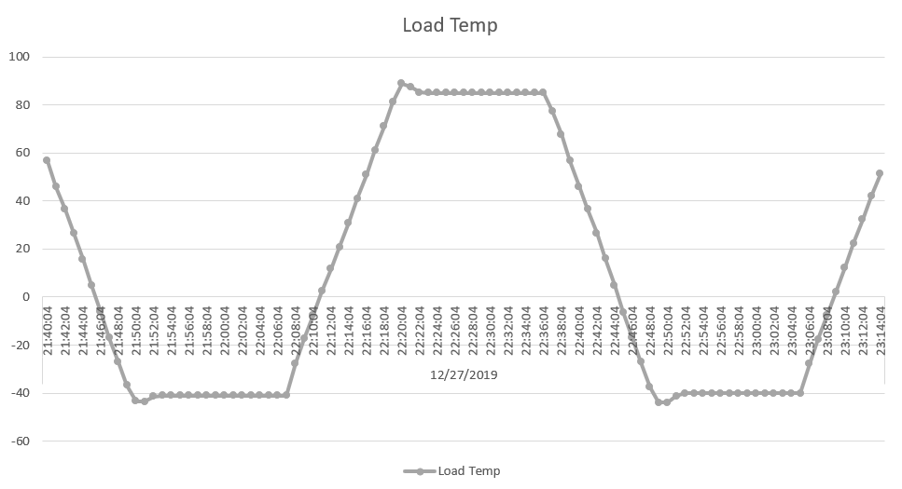
Enabled (or) Non-enabled Temperature Cycle Primer
TCX (Temperature Cycling – X) Profile Specifications:
Test Condition | Nominal Minimum | Nominal Maximum | Ramp Rate | Dwell Time | Cycle time
X | -40°C (+0°C, -10°C) | +85°C (+10°C, -0°C) | 10-15°C/min (typical) | Minimum 15 min | 60 min (total)
Example TC-X Profile:
Dwell Time [Maximum/Hot] (17 min)
Note:
Enabled Temperature Cycle means the DUT is subjected to a constant load simulating the presence of a heatsink or thermal solution during the course of the testing.
Non-enabled Temperature Cycle means the DUT is NOT subjected to a constant load simulating the presence of a heatsink or thermal solution during the course of the testing.
This example plot is just one implementation of the table parameters (above)
+85°C
Ramp Rate
(10°C/min)
0°C
Time (minutes)
-40°C
Cycle Time (60 min)
Dwell Time
[Minimum/Cold] (17 min)
Min = Minutes

